Slide 1


Scientific Machine Learning
Lecture 3: Regression (Part II)
孟旭辉
数学与统计学院数学与应用学科交叉创新研究院
办公室：欣苑2栋111室
Email：xuhui_meng@hust.edu.cn
https://github.com/XuhuiM/SciML-Course
2/27/2023

Slide 2
Contents
Gradient descent (GD) vs Stochastic gradient descent (SGD)
Underfitting and overfitting

Slide 3
Contents
Gradient descent (GD) vs Stochastic gradient descent (SGD)
Underfitting and overfitting

Slide 4
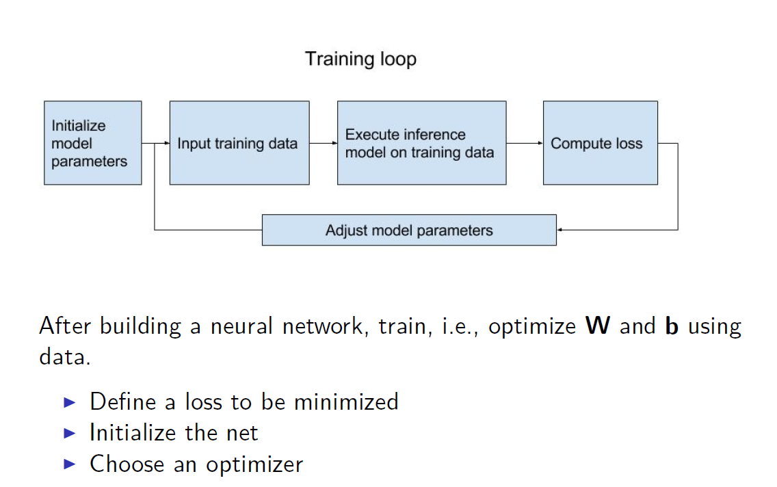
NN for regression problems

Slide 5

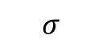
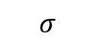
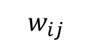
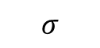
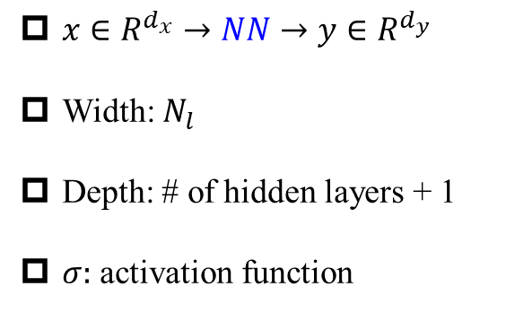

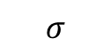
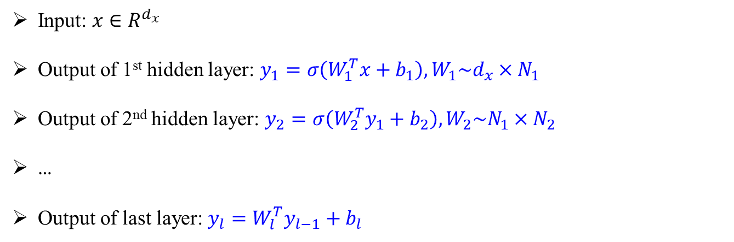
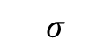
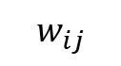
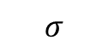
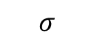
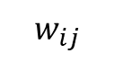
Deep Neural Networks (DNNs): Universal Approximation Theorem
$$w_{ij}$$
$$w_{ij}$$
$$σ$$
$$σ$$
$x∈R^{d_{x}}→NN→y∈R^{d_{y}}$
Width: $N_{l}$
Depth: # of hidden layers + 1
$σ:$ activation function
$$w_{ij}$$
$$σ$$
$$σ$$
y
$$σ$$
$$σ$$
$$σ$$
$$σ$$
Input: $x∈R^{d_{x}}$
Output of 1st hidden layer: $y_{1}=σ\left(W_{1}^{T}x+b_{1}\right), W_{1}\sim d_{x}×N_{1}$
Output of 2nd hidden layer: $y_{2}=σ\left(W_{2}^{T}y_{1}+b_{2}\right),W_{2}\sim N_{1}×N_{2}$
…
Output of last layer: $y_{l}=W_{l}^{T}y_{l−1}+b_{l}$
Hornik, et al, Neural Networks, 1989

Slide 6

DNNs: About activation functions
Remarks:
First choice: tanh
For very deep NNs, try ReLu-type activation function first

Slide 7
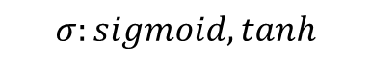
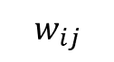
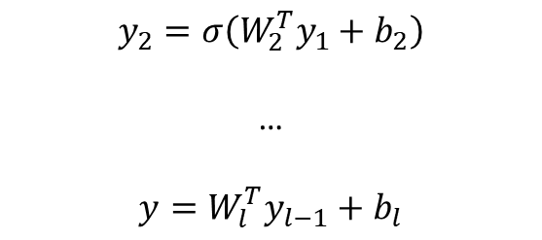

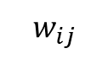
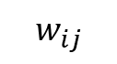
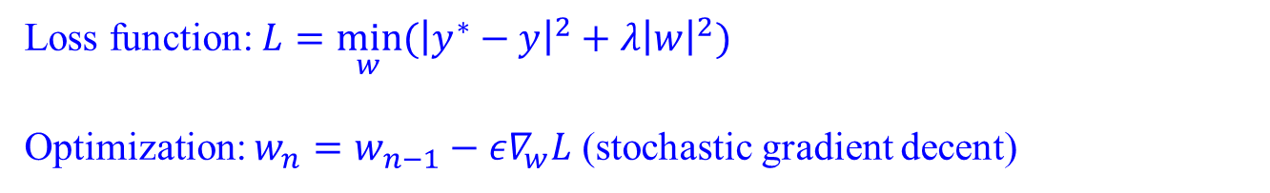
DNNs: Optimization
$$w_{ij}$$
$$w_{ij}$$
$$σ$$
$$σ$$
$$w_{ij}$$
$$y_{1}=σ(W_{1}^{T}x+b_{1})$$
$$σ$$
$$σ$$
$$y_{2}=σ\left(W_{2}^{T}y_{1}+b_{2}\right)$$
…
$$y=W_{l}^{T}y_{l−1}+b_{l}$$
y
$$σ$$
$$σ$$
$$σ$$
$$σ$$
$$σ:sigmoid, tanh$$
Standard multilayer feedforward networks are capable of approximating any measurable function to any desired degree of accuracy
Convergence rate increases as the number of hidden units grows
Loss function: $L={\min_{w}⁡(\left|y^{∗}−y\right|}^{2}+λ{\left|w\right|}^{2})$
Optimization: $w_{n}=w_{n−1}−{ε∇}_{w}L$ (stochastic gradient decent)
Hornik, et al, Neural Networks, 1989

Slide 8


On gradient descent algorithm
$w_{n}=w_{n−1}−{ε∇}_{w}L$

Slide 9
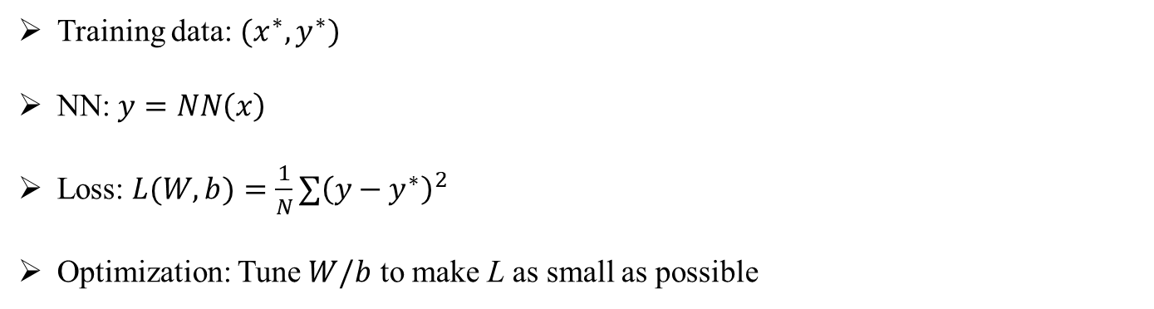

Optimization – Gradient descent algorithm
Training data: $(x^{∗},y^{∗})$
NN: $y=NN\left(x\right)$
Loss: $L(W,b)=\frac{1}{N}{∑\left(y−y^{∗}\right)}^{2}$
Optimization: Tune $W/b$ to make L as small as possible
$$L(W,b)≥0$$
$$∂_{W}L=0$$
W/b -> very high-dimensional
Local minima

Slide 10
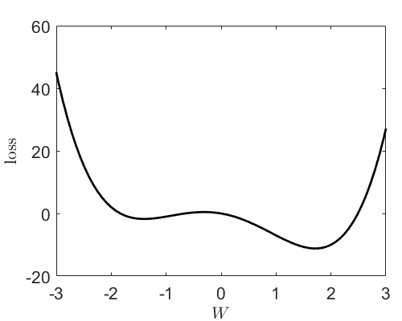
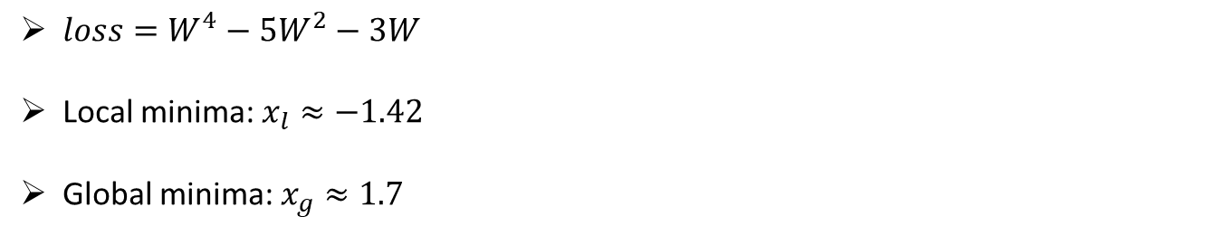
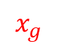
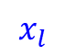
Gradient descent: Local minima
$loss=W^{4}−5W^{2}−3W$
Local minima: $x_{l}≈−1.42$
Global minima: $x_{g}≈1.7$
$$x_{l}$$
$$x_{g}$$

Slide 11

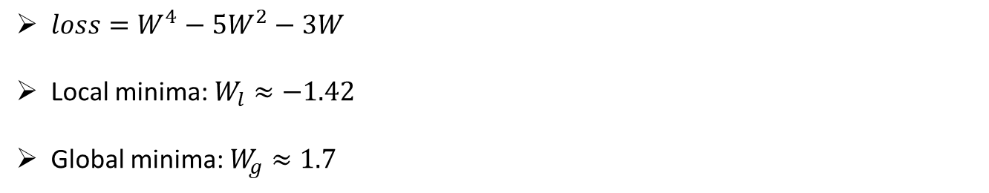



Gradient descent: Local minima
$loss=W^{4}−5W^{2}−3W$
Local minima: $W_{l}≈−1.42$
Global minima: $W_{g}≈1.7$
$w_{n}=w_{n−1}−{ε∇}_{w}L$
$$w_{0}=−3, ε={10}^{−2}$$
$$W_{l}$$
$$W_{g}$$

Slide 12
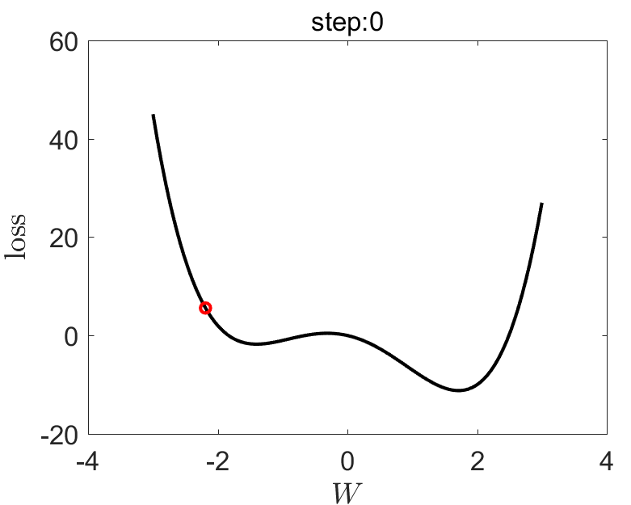
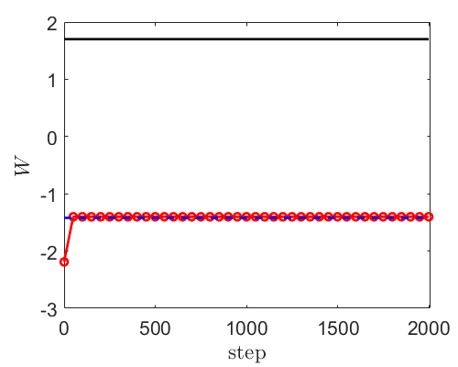




Gradient descent: Local minima
$loss=W^{4}−5W^{2}−3W$
Local minima: $W_{l}≈−1.42$
Global minima: $W_{g}≈1.7$
$w_{n}=w_{n−1}−{ε∇}_{w}L$
$$w_{0}=−3, ε={10}^{−2}$$
$$W_{l}$$
$$W_{g}$$

Slide 13
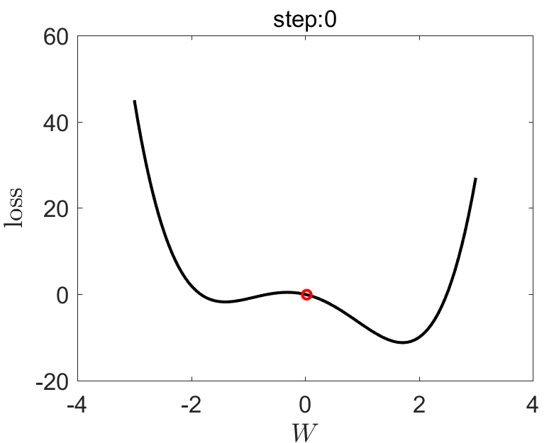
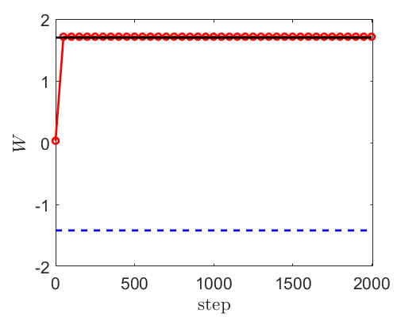
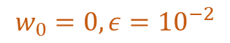
Gradient descent: Local minima
$loss=W^{4}−5W^{2}−3W$
Local minima: $W_{l}≈−1.42$
Global minima: $W_{g}≈1.7$
$w_{n}=w_{n−1}−{ε∇}_{w}L$
$$w_{0}=0, ε={10}^{−2}$$
$$W_{l}$$
$$W_{g}$$

Slide 14
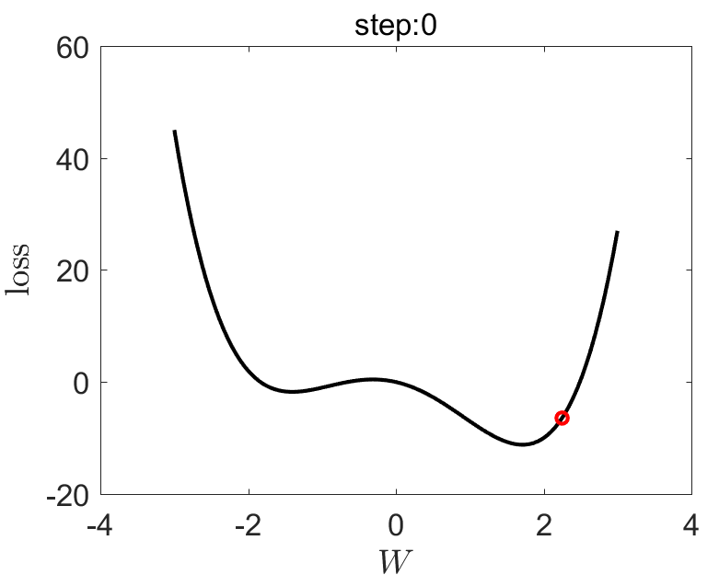
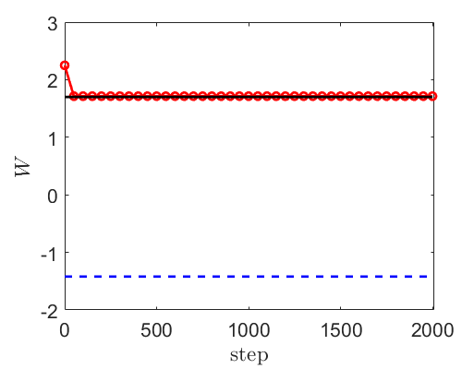

Gradient descent: Local minima
$loss=W^{4}−5W^{2}−3W$
Local minima: $W_{l}≈−1.42$
Global minima: $W_{g}≈1.7$
$w_{n}=w_{n−1}−{ε∇}_{w}L$
$$w_{0}=3, ε={10}^{−2}$$
$$W_{l}$$
$$W_{g}$$

Slide 15
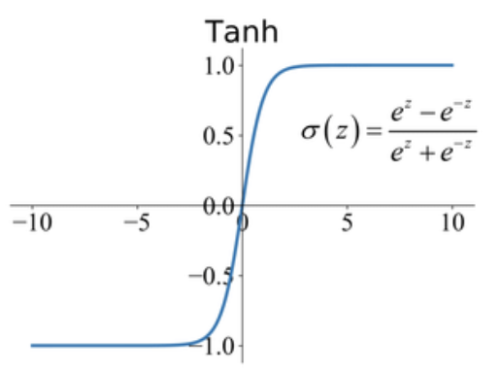
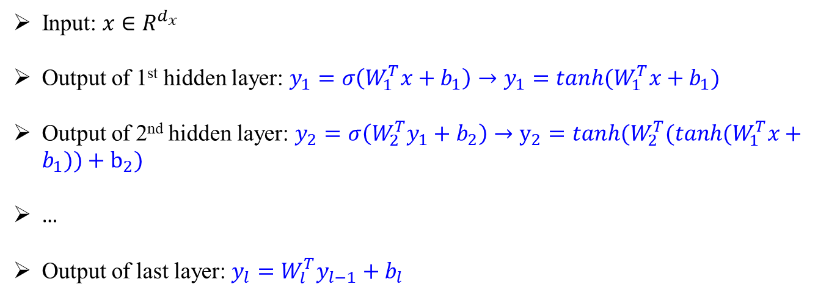
Deep Neural Networks (DNNs)
$$w_{ij}$$
$$w_{ij}$$
$$σ$$
$$σ$$
$$w_{ij}$$
$$σ$$
$$σ$$
y
$$σ$$
$$σ$$
$$σ$$
$$σ$$
Input: $x∈R^{d_{x}}$
Output of 1st hidden layer: $y_{1}=σ\left(W_{1}^{T}x+b_{1}\right)→y_{1}=tanh⁡(W_{1}^{T}x+b_{1})$
Output of 2nd hidden layer: $y_{2}=σ\left(W_{2}^{T}y_{1}+b_{2}\right)→y_{2}=tanh(W_{2}^{T}(tanh⁡(W_{1}^{T}x+b_{1}))+b_{2})$
…
Output of last layer: $y_{l}=W_{l}^{T}y_{l−1}+b_{l}$

Slide 16
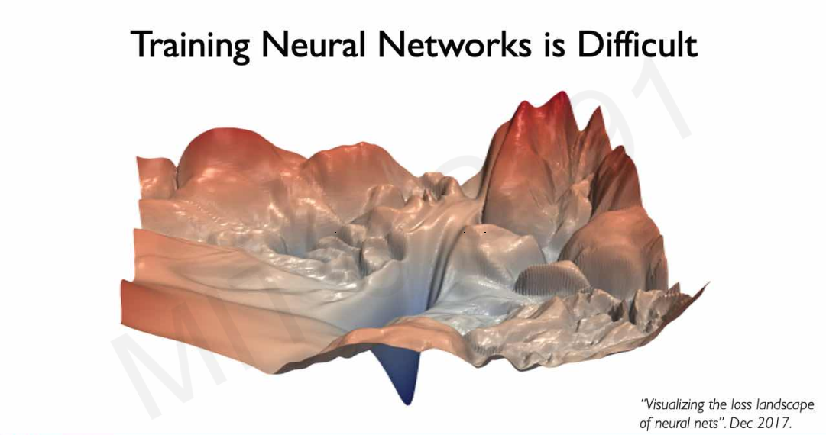
Gradient descent for NNs

Slide 17


Stochastic gradient descent
$w_{n}=w_{n−1}−ε∇_{w_{n−1}}L=w_{n−1}+δw_{n−1}$
$δw_{n−1}≈0 as ∇_{w_{n−1}}L→0$
Define $δw_{n−1}=−ε\left(∇_{w_{n−1}}L+η\right), η\sim N\left(0,I\right)$
Avoid being trapped in local minima

Slide 18

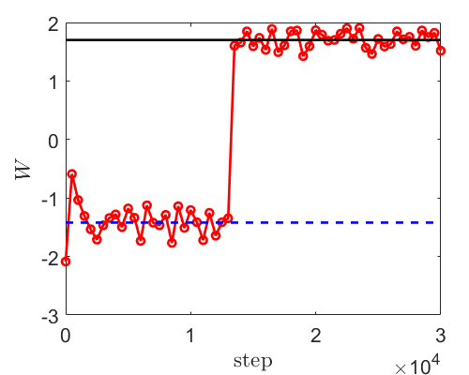




Stochastic gradient descent
$loss=W^{4}−5W^{2}−3W$
Local minima: $W_{l}≈−1.42$
Global minima: $W_{g}≈1.7$
$w_{n}=w_{n−1}−{ε∇}_{w}L$
$$w_{0}=−3, ε={10}^{−2}$$
$$W_{l}$$
$$W_{g}$$
$δw_{n−1}=−ε\left(∇_{w_{n−1}}L−η\right), η\sim 10N\left(0,I\right)$

Slide 19

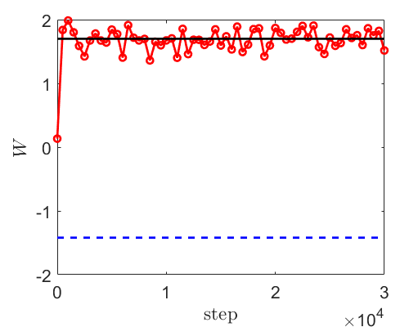
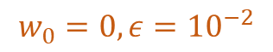
Stochastic gradient descent
$loss=W^{4}−5W^{2}−3W$
Local minima: $W_{l}≈−1.42$
Global minima: $W_{g}≈1.7$
$w_{n}=w_{n−1}−{ε∇}_{w}L$
$$w_{0}=0, ε={10}^{−2}$$
$$W_{l}$$
$$W_{g}$$
$δw_{n−1}=−ε\left(∇_{w_{n−1}}L−η\right), η\sim 10N\left(0,I\right)$

Slide 20
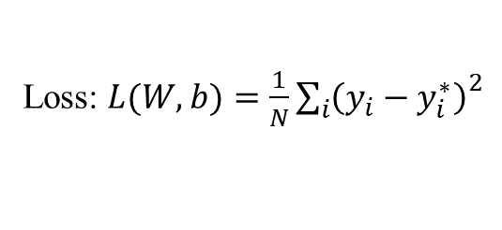
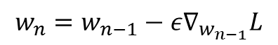
Gradient Descent: Big data problems
Loss: $L(W,b)=\frac{1}{N}{\sum_{i}{\left(y_{i}−y_{i}^{∗}\right)}}^{2}$
$$w_{n}=w_{n−1}−ε∇_{w_{n−1}}L$$

Slide 21
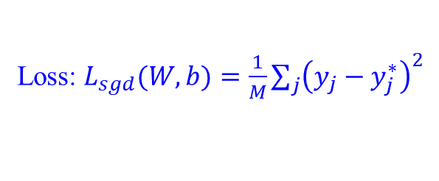
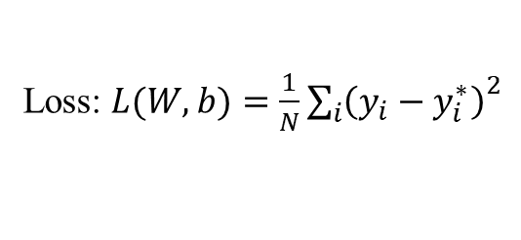
Stochastic gradient descent
Loss: $L(W,b)=\frac{1}{N}{\sum_{i}{\left(y_{i}−y_{i}^{∗}\right)}}^{2}$
$w_{n}=w_{n−1}−ε∇_{w_{n−1}}L=w_{n−1}+δw_{n−1}$
$δw_{n−1}=−ε\left(∇_{w_{n−1}}L+η\right), η\sim N\left(0,I\right)$
Loss: $L_{sgd}(W,b)=\frac{1}{M}\sum_{j}{{\left(y_{j}−y_{j}^{∗}\right)}^{2}}$
$$∇_{w}L≈∇_{w}L_{sgd}+η→∇_{w}L_{sgd}≈∇_{w}L+η$$
$$w_{n}=w_{n−1}−ε∇_{w_{n−1}}L_{sgd}$$
Avoid being trapped into local minima
Big data problems

Slide 22
Gradient Descent vs Stochastic gradient descent
 | GD | SGD
Convergence rate | ✓
Accuracy | ✓
Initialization |  | ✓
Big data |  | ✓

Slide 23
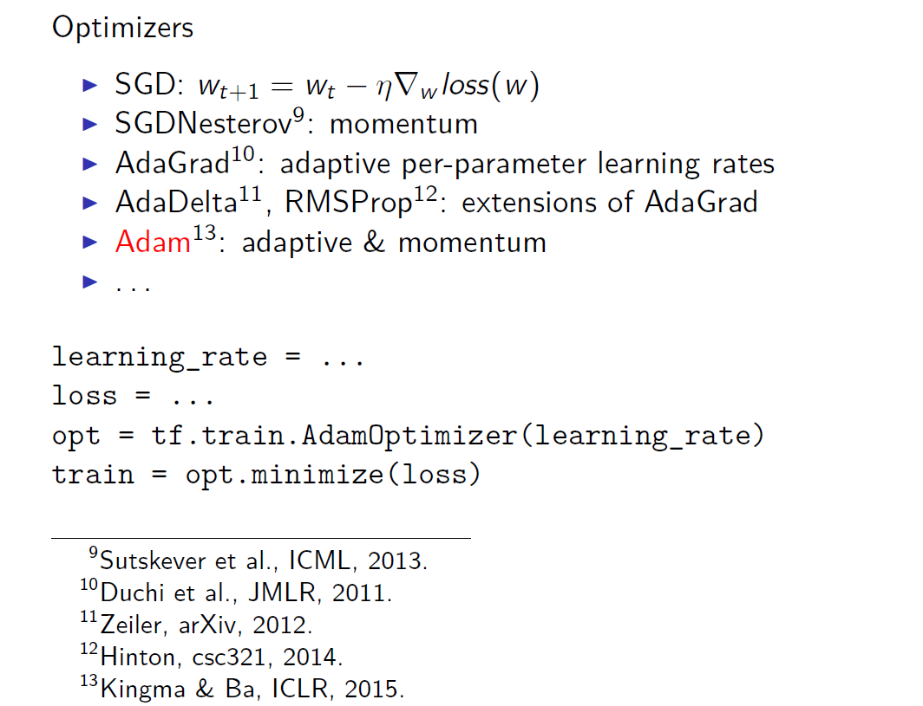
Optimizer

Slide 24

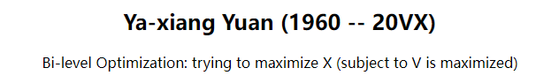
Optimization
Max X
s.t. Max V
袁亚湘教授

Slide 25
Contents
Gradient descent (GD) vs Stochastic gradient descent (SGD)
Underfitting and overfitting

Slide 26
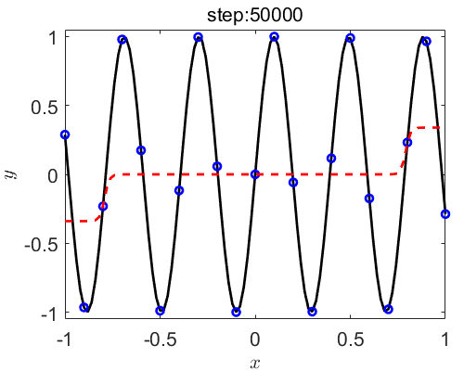
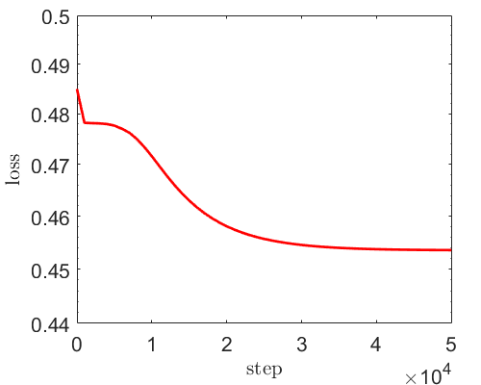
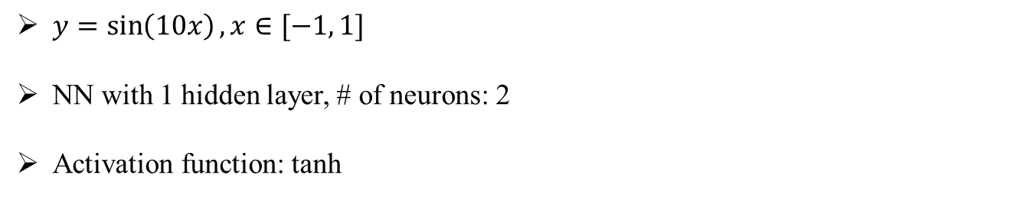
Underfitting
$y=\sin\left(10x\right), x∈[−1, 1]$
NN with 1 hidden layer, # of neurons: 2
Activation function: tanh

Slide 27
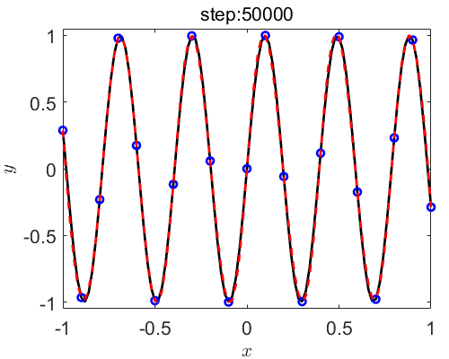
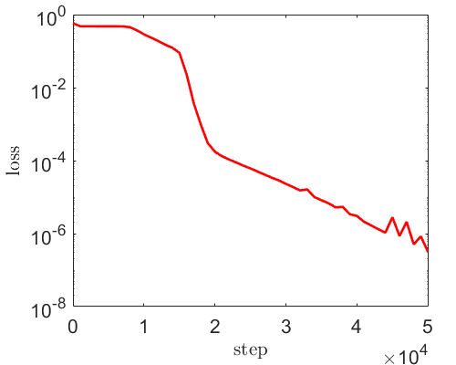
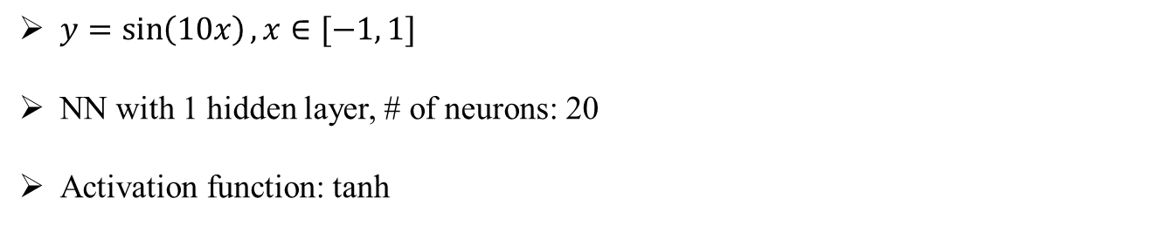
Underfitting
$y=\sin\left(10x\right), x∈[−1, 1]$
NN with 1 hidden layer, # of neurons: 20
Activation function: tanh

Slide 28
Underfitting
$y=\sin\left(10x\right), x∈[−1, 1]$
NN with 1 hidden layer, # of neurons: 20
Activation function: tanh

Slide 29



Underfitting
$y=\sin\left(10x\right), x∈[−1, 1]$
NN with 2 hidden layer, # of neurons: 20
Activation function: tanh
Increase width/depth of NN

Slide 30



Overfitting
$y=\sin\left(10x\right), x∈[−1, 1]$
Activation function: tanh
$$1×20$$
$$2×20$$

Slide 31



Overfitting
$$4×20$$

Slide 32
Overfitting

Slide 33

Overfitting

Slide 34

DNNs: Optimization
$$w_{ij}$$
$$w_{ij}$$
$$σ$$
$$σ$$
$$w_{ij}$$
$$y_{1}=σ(W_{1}^{T}x+b_{1})$$
$$σ$$
$$σ$$
$$y_{2}=σ\left(W_{2}^{T}y_{1}+b_{2}\right)$$
…
$$y=W_{l}^{T}y_{l−1}+b_{l}$$
y
$$σ$$
$$σ$$
$$σ$$
$$σ$$
$$σ:sigmoid, tanh$$
Loss function: $L={\min_{w}⁡(\left|y^{∗}−y\right|}^{2}+λ{\left|w\right|}^{2})$
Optimization: $w_{n}=w_{n−1}−{ε∇}_{w}L$ (stochastic gradient decent)

Slide 35



Overfitting: Regularization
Loss function: $L={\min_{w}⁡(\left|y^{∗}−y\right|}^{2}+λ{\left|w\right|}^{2})$
$λ={10}^{−5}$

Slide 36




Overfitting: Regularization
Loss function: $L={\min_{w}⁡(\left|y^{∗}−y\right|}^{2}+λ{\left|w\right|}^{2})$
$λ={10}^{−3}$
$L_{2}$ regularization is a commonly used approach to reduce overfitting
Carefully tune $λ$

Slide 37

第一次作业
一维$函数拟合问题$
研究训练点数目、网络结构（隐藏层层数、激活函数等）对预测精度的影响
作业方式：代码+报告
时间：三周

Slide 38

Thank you for your attention!

